Slide 1
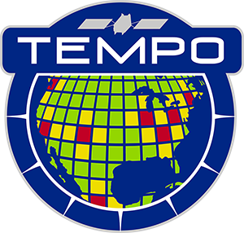



Tropospheric Emissions:
Monitoring of Pollution
TEMPO Mission Status
Xiong Liu¹, K. Chance¹, C.R. Nowlan¹, G. Gonzalez Abad¹, R. Suleiman¹, J. Houck¹, J. Davis¹, H. Wang¹, H. Chong¹, W. Hou¹, J. Park¹, J. Bak¹, L. Carpenter¹,
C. Chan Miller¹, J. Fitzmaurice¹, A. Oppenheimer¹, E. O’Sullivan¹,
K. Daugherty², D.E. Flittner², C. Fenn², D. Rosenbaum², C. Brown², N. Mishra²,
R.T. Neece² , E. Roback², J. Strickland², L. Judd², P. Rawat², K. Travis², J. Carr³,
J. Szykman⁴, B. Henderson⁴, L. Valin⁴, J. Joiner⁵, Z. Fasnacht⁵, S. Frith⁵,
D. Haffner⁵, E. Knowland⁵, N. Kramarova⁵, N. Krotkov⁵, C. Li⁵, W. Qin⁵,
G. Jaross⁵, C. Seftor⁵, A. Vasilkov⁵, E.-S. Yang⁵, J. Ziemke⁵, M. Newchurch⁶,
Naeger⁶, R. Cohen⁷, J. Geddes⁸, J. Herman⁹, B. Pierce¹⁰, R. Spurr¹¹,
S. Kondragunta¹², J. Wang¹³, O. Torres⁵, H. Zhang¹², P. Ciren¹²,
X. Zhao¹⁴, and the TEMPO Team
¹Smithsonian Astrophysical Observatory (SAO), CfA
²NASA LaRc ³Carr Astro. ⁴EPA ⁵NASA GSFC ⁶UAH ⁷UCB
⁸BU ⁹UMBC ¹⁰UWM ¹¹RT Sol. Inc ¹²NOAA ¹³UI ¹⁴ECCC
TEMPO/GeoXO ACX Joint Science Team Workshop
Cambridge, MA
August 19-22, 2025

Slide 2
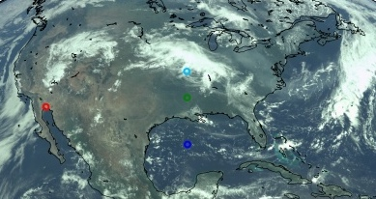
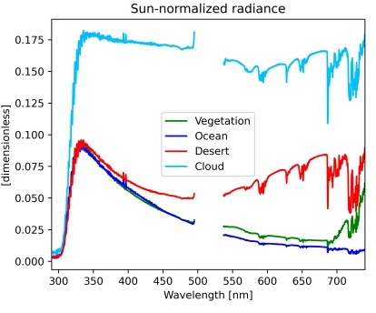
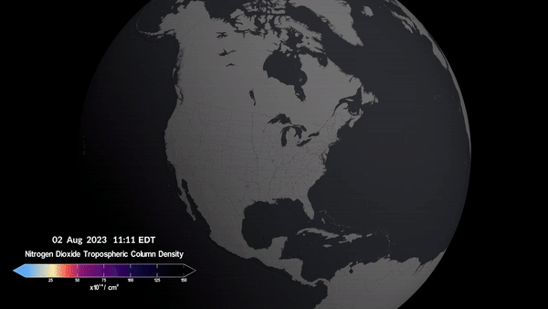
Tropospheric Emissions:
Monitoring of Pollution
NASA’s first Earth Venture Instrument (EVI-1), selected in 2012
Led by Smithsonian Astrophysical Observatory (SAO) in partnership with NASA LaRC, with instrument built by Ball Aerospace (now part of BAE Systems)
NASA’s first GEO & host payload, launched on board Intelsat-40e in April 2023 on to the GEO at 91 ∘ W
Hourly daytime air pollution over North America at neighborhood scale (2x4.75 km² at the center of the field of regard)
Global Geostationary Air Quality Constellation along with GEMS (2020) and Sentinel-4 (7/2025)
538-741 nm
293-494 nm
TEMPO first light RGB and examples of spectra
Credit: Heesung Chong
Credit: NASA’s Scientific Visualization Studio

Slide 3
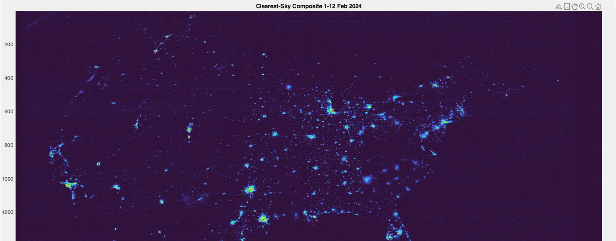
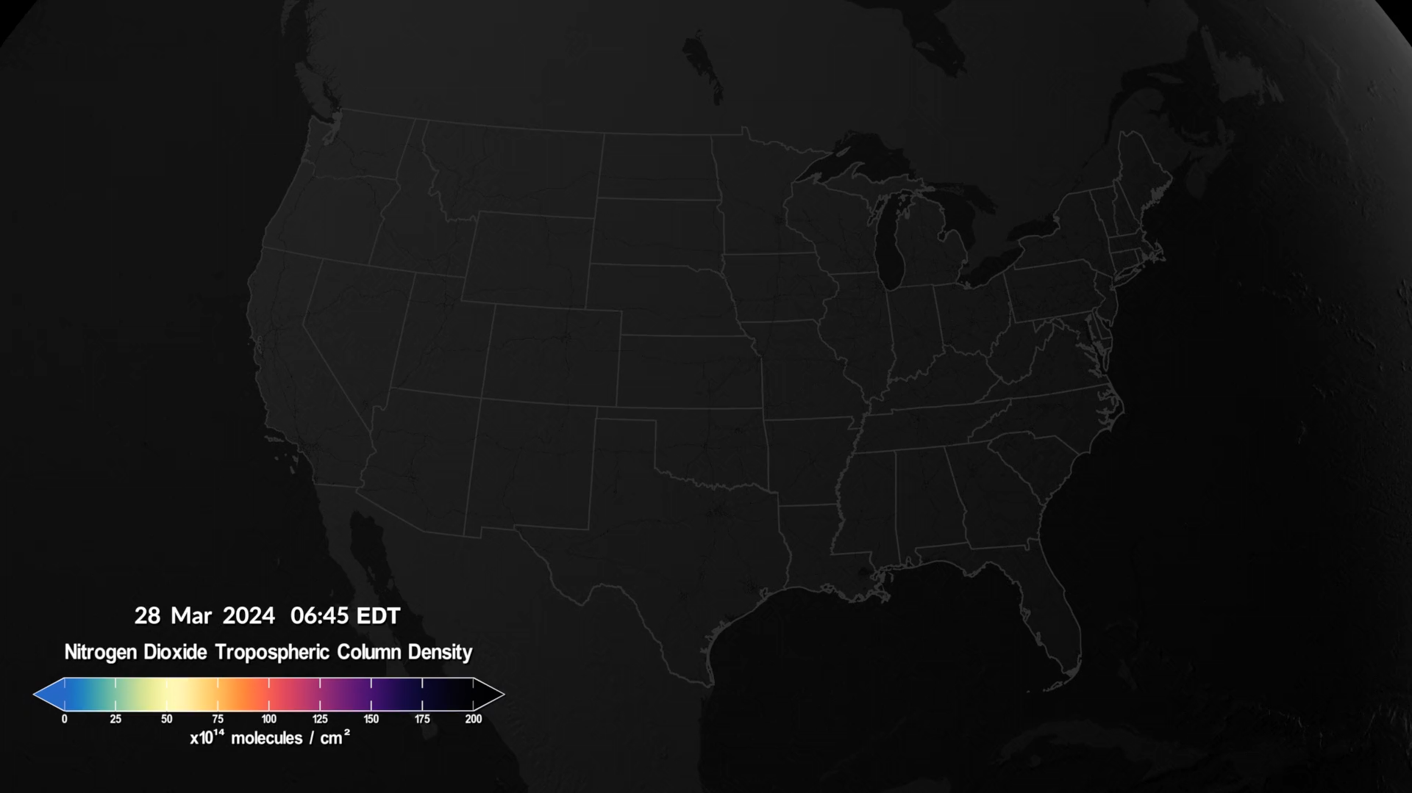
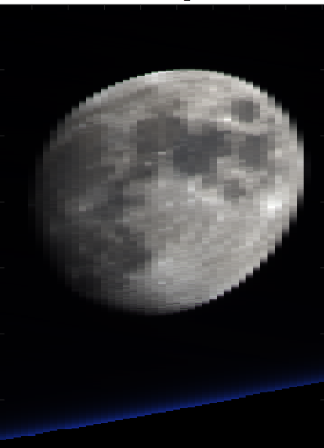
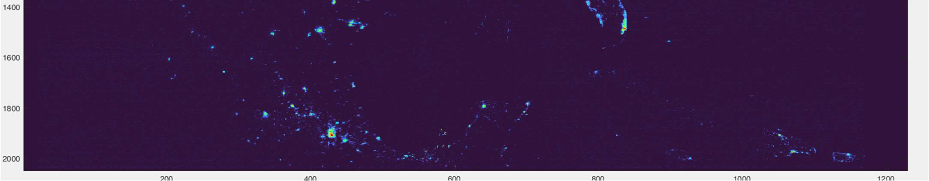

TEMPO Scanning
Nominal scans: hourly, 2.4M pixels
  2035 North/South pixels
  1181 East/West steps per hour
  2 x 4.75 km² at center of field of regard
Optimized scans
  Higher temporal resolution scans in early AM and late PM over coasts (40 mins)
Twilights scans (science bonus & discovery)
  Performed during darkness (~Aug. 15-Apr. 15)
  City lights, moonlights, Aurora, airglow, gas flaring, lightning, fires
Special observations to support TEMPO Green Paper: 21 days in 2025 for wildfires, prescribed burning, lightning NOx, CO Front Range field campaigns, CAL/VAL
  High-time scans (5-10 mins) over selected regions (alternate hourly scan /
  1 hour high-time scans)
  Lunar collect (4/9/2025)
  RRV 2024/2025 (side slither)
Clearest-Sky City lights Composite 1–12 February 2024
Credit: NASA’s Scientific Visualization Studio
Radiance derivation → Post-processing (de-speckling, de-streaking, etc.) → Composite
Request special observations at TEMPO Early Adopter Website
Credit: Jim Carr

Slide 4
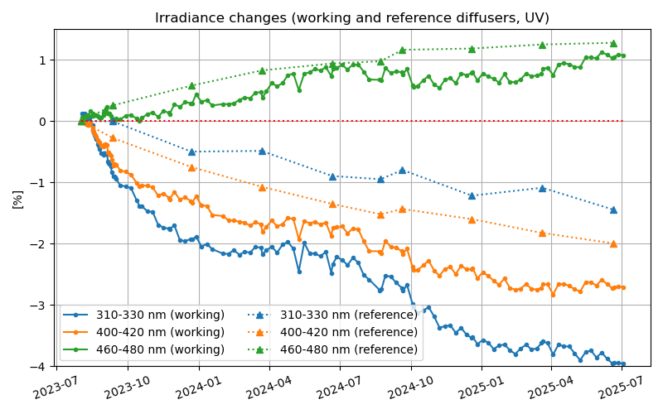
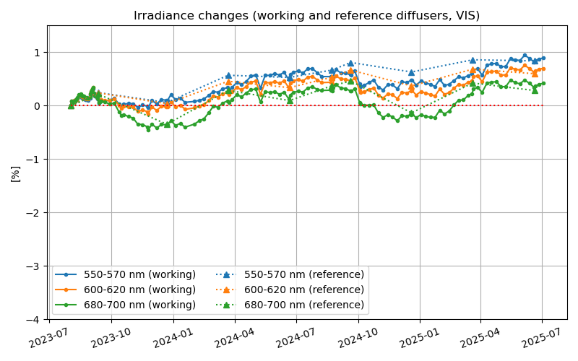
TEMPO Timeline & Status
Date | Details
7 April 2023 | Launch
June-July 2023 | TEMPO power on + dry-out, cool down, etc.
2 August 2023 | First light
19 October 2023 | Nominal operations
18 June 2025 | Baseline mission ends (end of prime mission review on 10 Oct. 2025)
September 2026 | First extended mission ends, further extension by NASA senior reviews (next in March 2026)
Very small degradation in 2 years even for short UV, correctable in future versions.
Credit: Heesung Chong & Dave Flittner
Successful TEMPO commissioning and nominal operation, instrument performing very well

Slide 5
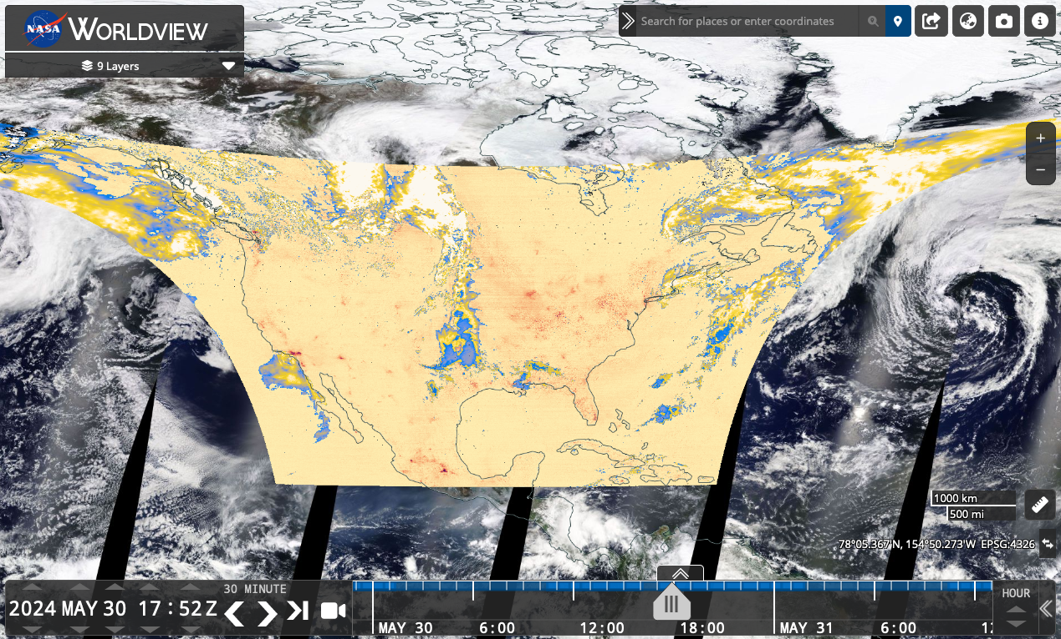

TEMPO Data Products Public Release
NASA’s Atmospheric Science Data Center (ASDC)
Public Release | Date | Details
V01 | Feb. 2024 | Limited 3 weeks released
V02 | Feb. 2024 | Level 1 (spectra) released
V03 | May 2024 | L1 updated, Level 2/3 cloud, NO₂, HCHO, total O₃ V3 O₃ profile (ASDC June 9, 2025, not for the public)
V04 | 9/15/2025 | Release ozone profile, update L1 + other L2/L3
NRT V02 | 9/15/2025 | L1, Level 2/3 cloud, NO₂, HCHO (funded by SNWG)
TEMPO data now publicly available at NASA’s ASDC (~6 hours latency).
Multiple tools:
  Earthdata Search, OPeNDAP
  NASA Worldview: all data products (L2+L3)
  ArcGIS services: currently L3 NO₂ +
  HCHO ^{new} + total ozone ^{new}
  RSIG (EPA)
  TEMPO-Lite (CfA CosmicDS): L3 NO₂
  NASA SPoRT Viewer
  Google Earth Engine (L3 NO2 & HCHO) ^{new}
For more information check out:
  User Guides (known issues)
  Daily operation & commissioning logs
  Validation reports (coming soon)
  ATBD (drafts available upon request for L0-1, L2 ATBDs released for cloud, NO2, & HCHO)
ASDC TEMPO
V3 download metrics (May 2024-Aug 12, 2025)
2.8 PB (1st instrument to reach 2 PB within 1 year)
101M files
890 unique users

Slide 6
Baseline TEMPO Data Products
Level | V3 Product | Validation Status
L1 | Irradiance | Provisional
 | Radiance | Provisional
 | Radiance (twilight – city lights) | Provisional
L2 | Clouds | Provisional
 | NO₂ | Provisional
 | HCHO | Provisional
 | O₃ (total) | Provisional
 | O₃ (profile) | Beta, June 9, 2025
L3 | L2 gridded to 0.02° × 0.02° | Provisional
Level | V4 Product | Validation Status
L1 | Irradiance | Provisional
 | Radiance | Provisional
 | Radiance (twilight – city lights) | Provisional
L2 | Clouds | Provisional
 | NO₂ | Provisional
 | HCHO | Provisional
 | O₃ (total) | Provisional
 | O₃ (profile) | Beta
L3 | L2 gridded to 0.02° × 0.02° | Provisional
The data products are upgraded to provisional status after the validation team approval in Dec. 2024!
*Beta: “minimally validated”, publication “not recommended and highly discouraged”
*Provisional: “performance demonstrated”, "suitable for scientific publication”

Slide 7
Baseline TEMPO Data Products +
SNWG TEMPO NRT + TEMPO Enhanced
Level | Product | Developer
L1 | Irradiance | SAO
 | Radiance ^{NRT} | SAO
 | Radiance (twilight – city lights) | SAO
L2 | Cloud ^{NRT} | SAO/GSFC
 | NO₂ ^{NRT} | SAO
 | HCHO ^{NRT} | SAO
 | O₃ (total) | SAO/GSFC
 | O₃ (profile) | SAO
 | TEMPO/GOES-R synergy aerosol product ^{NRT} | NOAA (released 1 yr data)
 | C₂H₂O₂ | SAO
 | H₂O | SAO
 | BrO | SAO
 | SO₂ ^{NRT} | NASA GSFC (under develop.)
 | UVAOD | NASA GSFC (under develop.)
 | Aerosol layer height | U. Iowa (under develop.)
 | UVB | NASA GSFC (under develop.)
Baseline Products
Satellite Needs Working Group (SNWG)
Cycle 3 NRT Products (~2-3 hours)
Public release (Sep. 15, 2025)
SNWG Cycle 4
TEMPO Enhanced Products
To be funded ~Q3 2025 (?)
Research Products
  Ocean color (funded by ROSES TEMPO/ACX)
  Vegetation (GPP)
  City lights/lighting types
  HNO₂
  Free tropospheric NO₂
  Surface concentrations
  Emissions
  Surface albedo
  IO
  NO₃
  Solar induced fluorescence

Slide 8
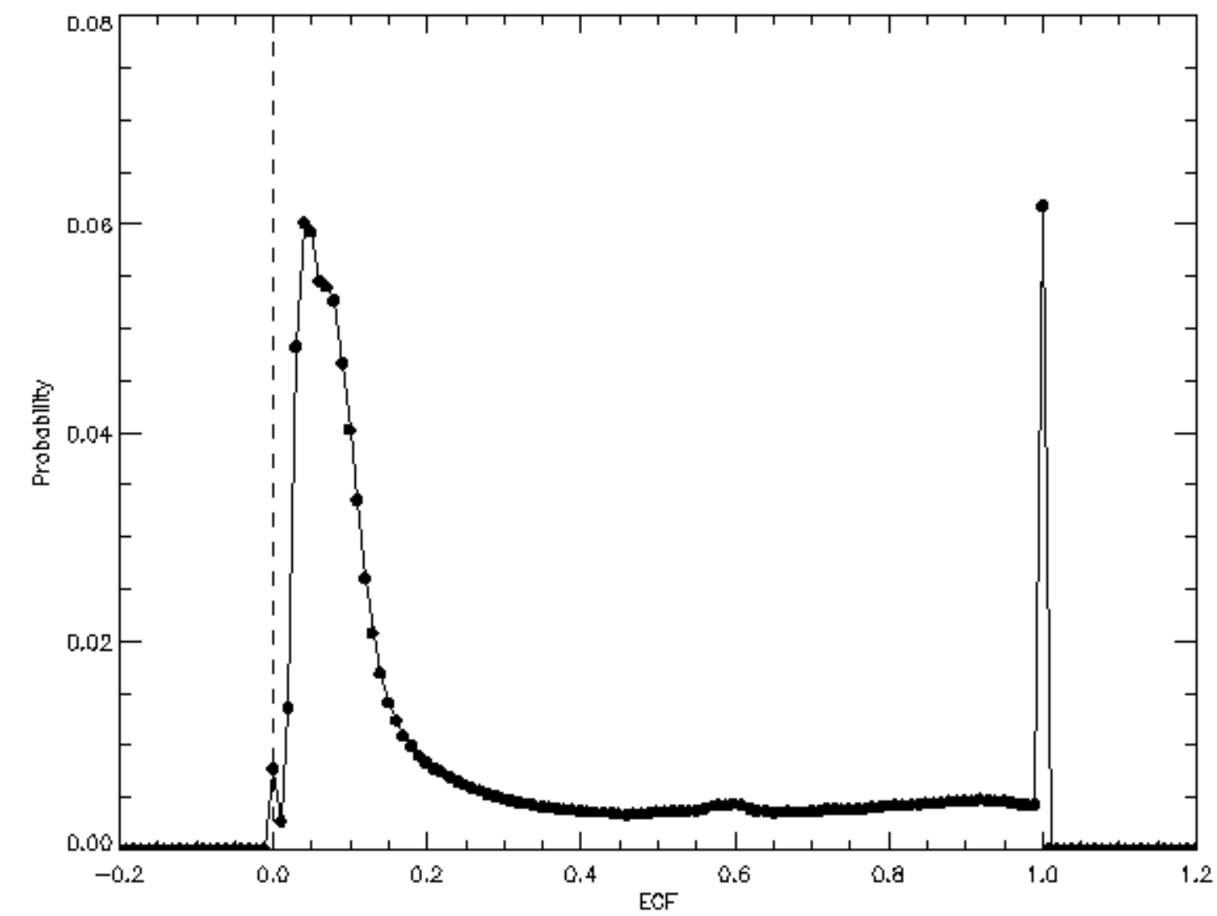
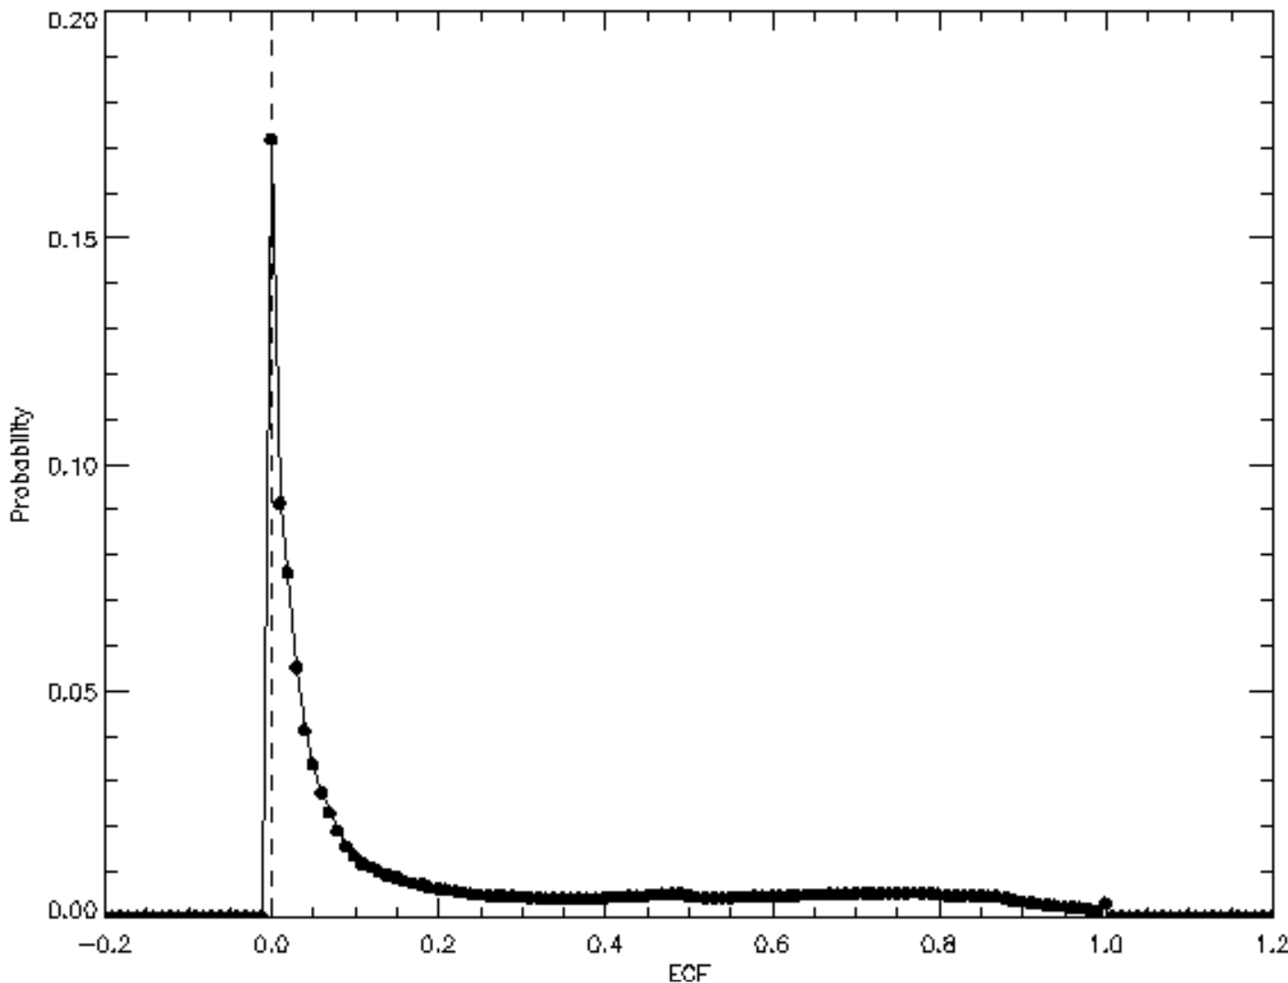
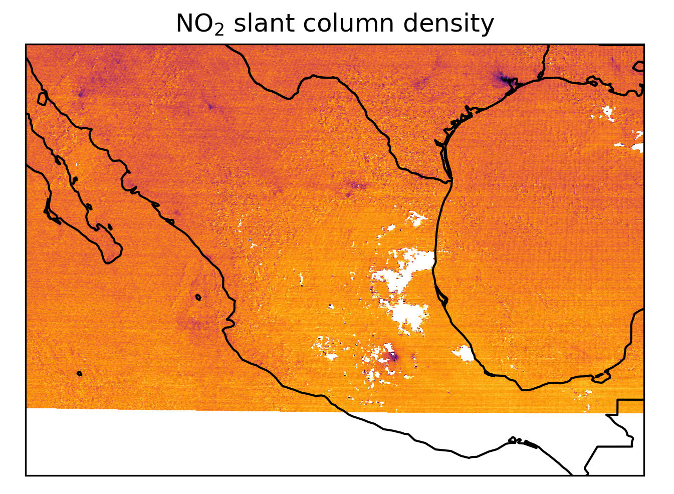
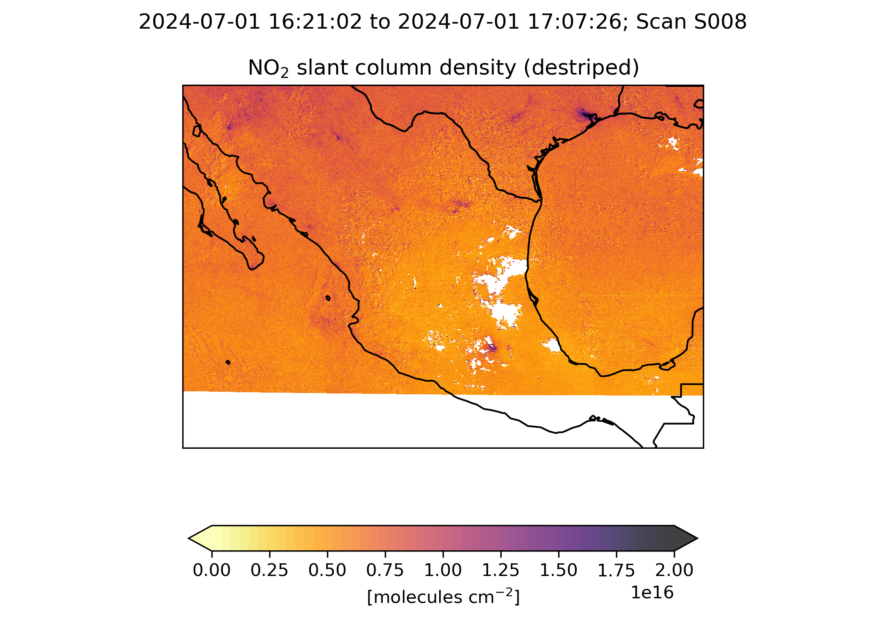
Algorithm Updates for TEMPO V4 (NRT V2)
GEOS-CF (meteorology / a priori): V1 → V2
L1b: Improve absolute calibration (~10% overestimation in normalized radiance)
  Update BTDF by ~cos(30°) and scattering angle dependence, update to radiometric calibration coefficients based on ABI/VIIRS comparison
  Improve straylight correction (over correction in V3): improve PSF + background correction + reconstruct saturated pixels
  Improve wavelength calibration, and wavelength grid for rad. cal. coefficients
  Improve INR (geolocation)
Trace gases and clouds
  NO₂ / O₂-O₂ de-striping
  Greatly Improved GLER surface albedo climatology (fix RAA clipping & BRDF clipping)
  Fix surface pressure anomaly (index shift by 1 in GEOS-CF surface pressure)
  Include clear-sky AMF & scattering weights for NO₂/HCHO
Histogram of Effective Cloud Fraction (ECF)
TEMPO V3 in NASA ASDC
TEMPO V4*
20240601 all scans
20240601 all scans
histogram peaks at ECF ~ 0.05,
suggesting an overestimate.
ECF histogram peaks ~0.0, primary
due to L1b update & GLER

Slide 9
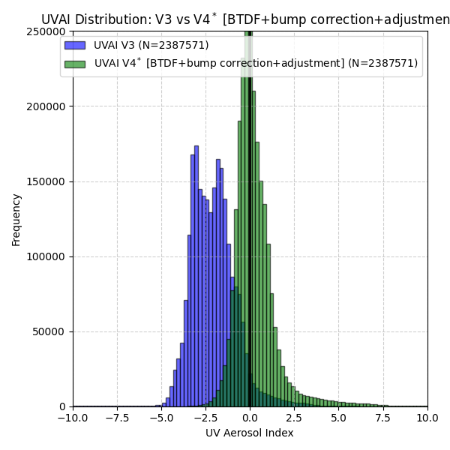
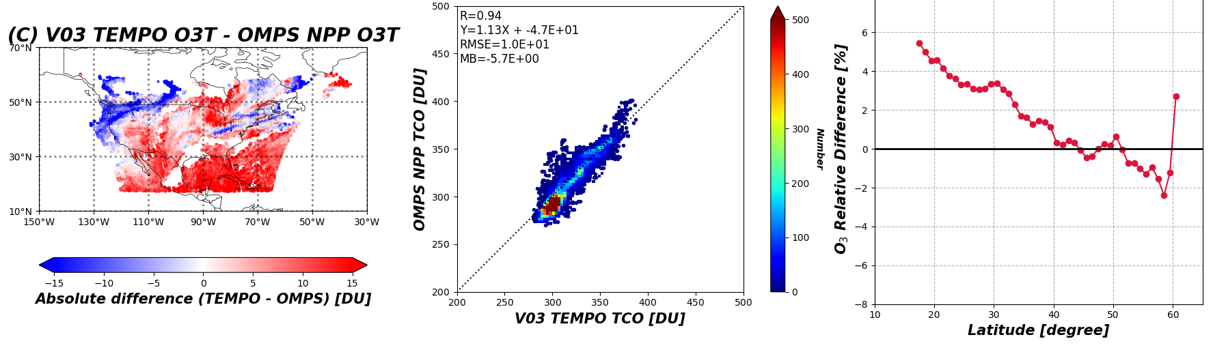
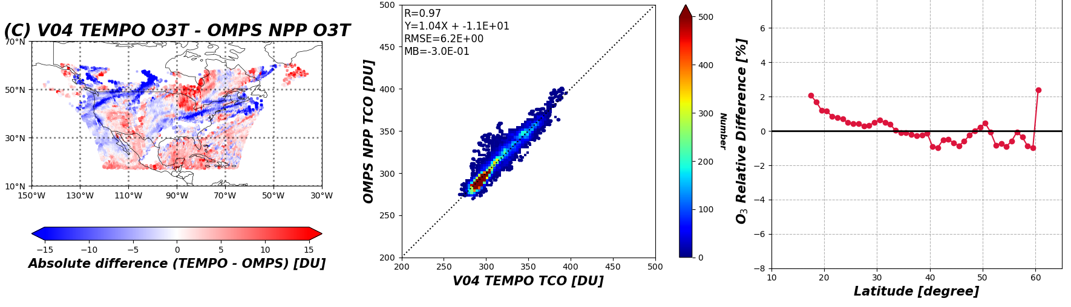
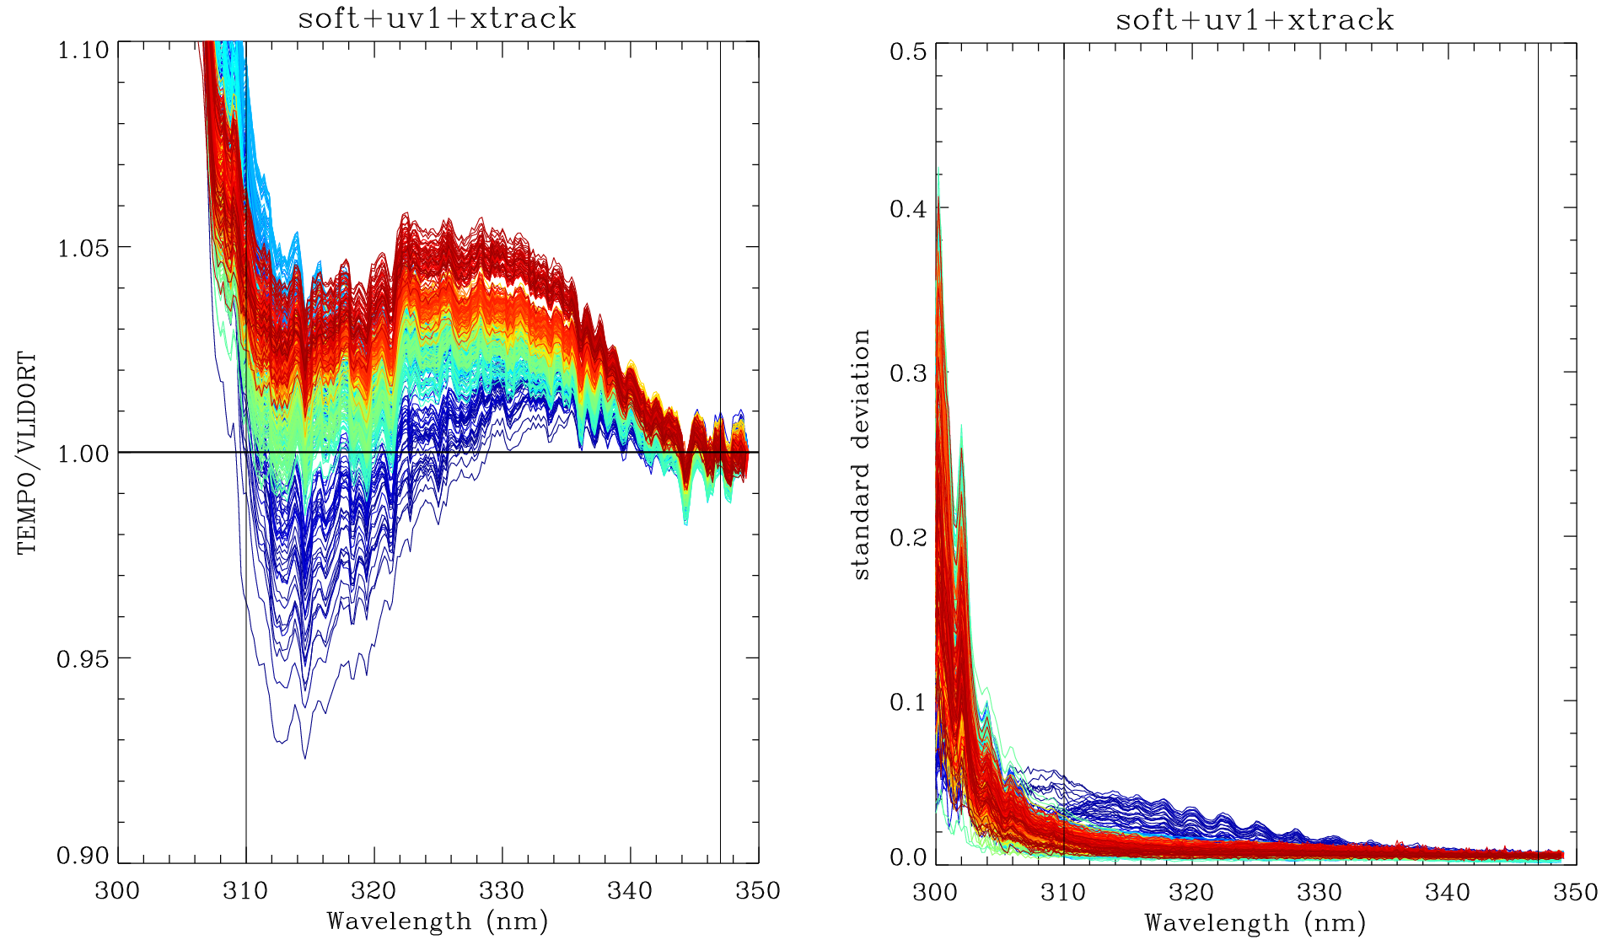
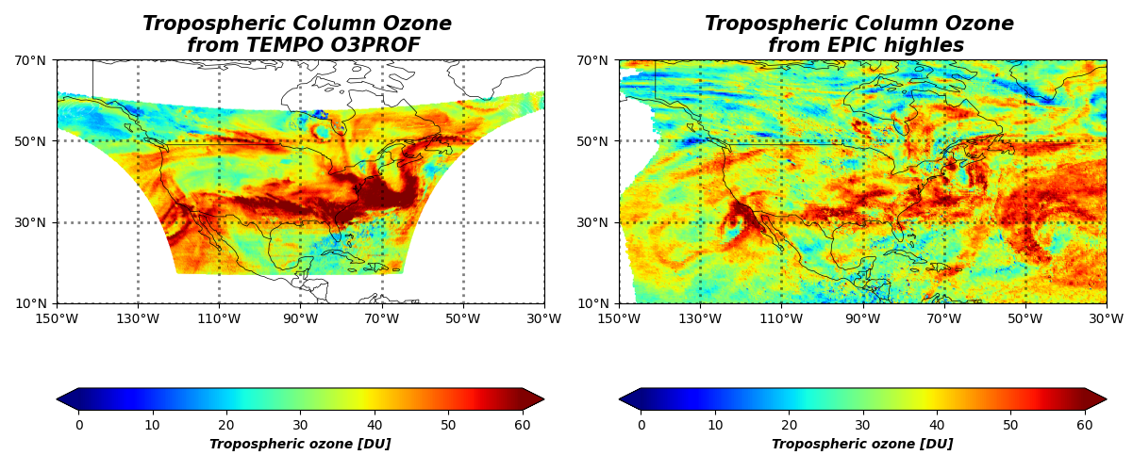
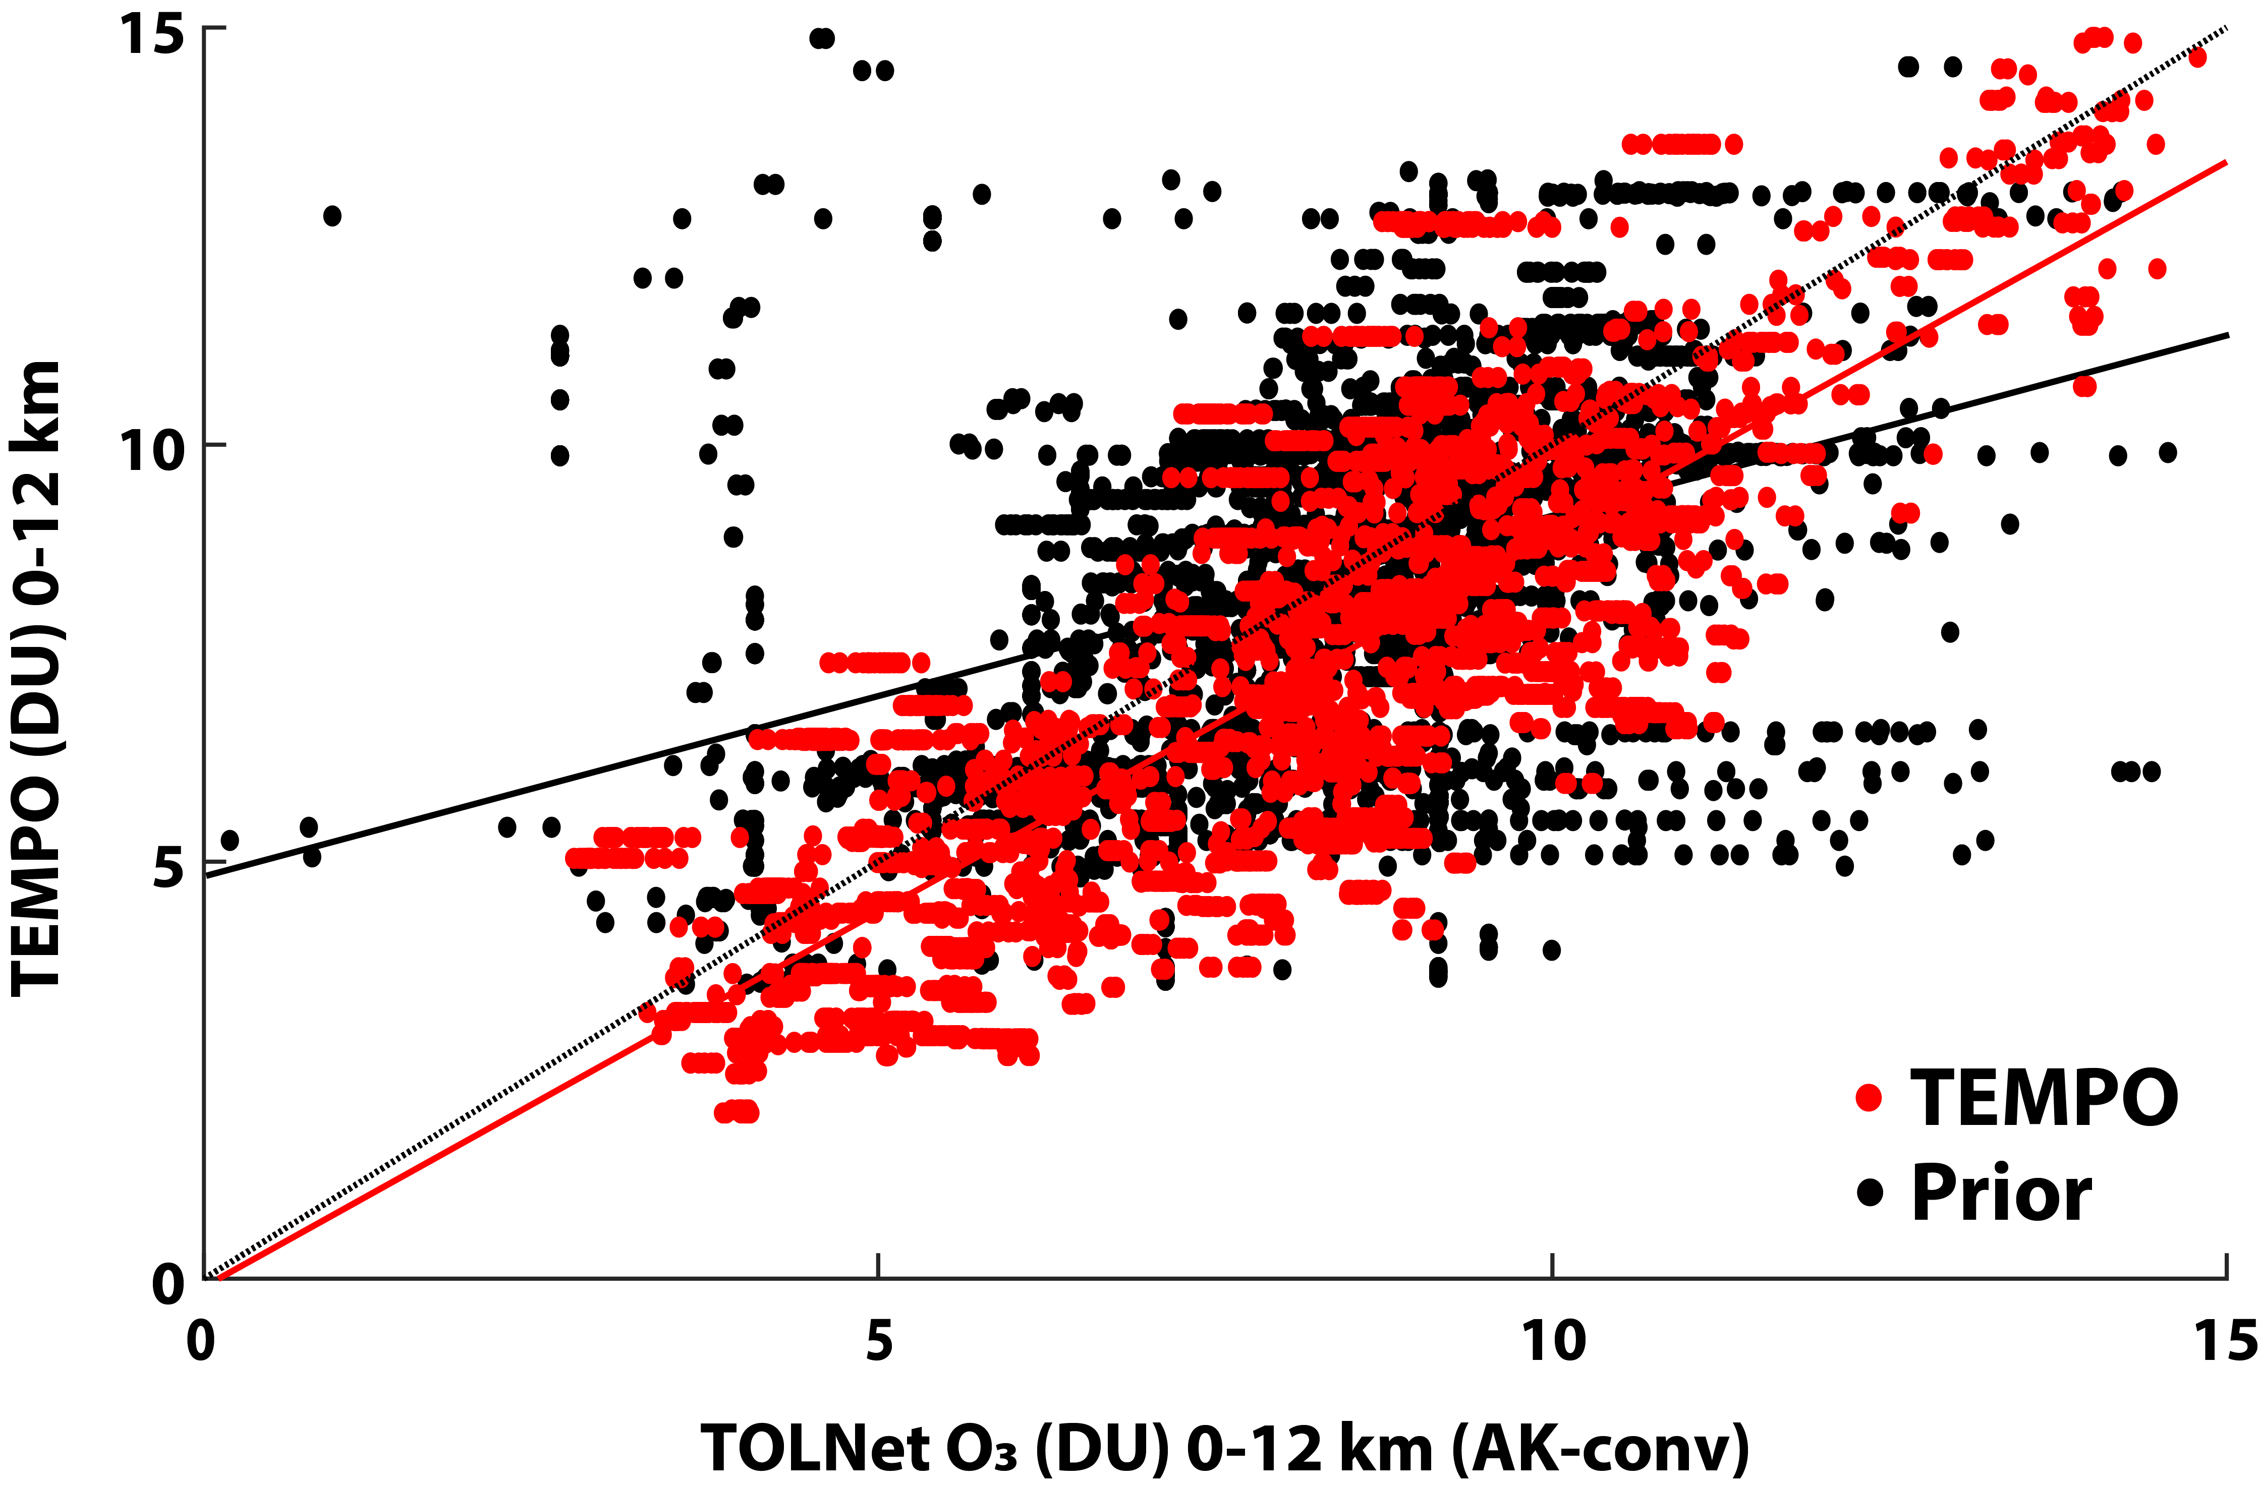
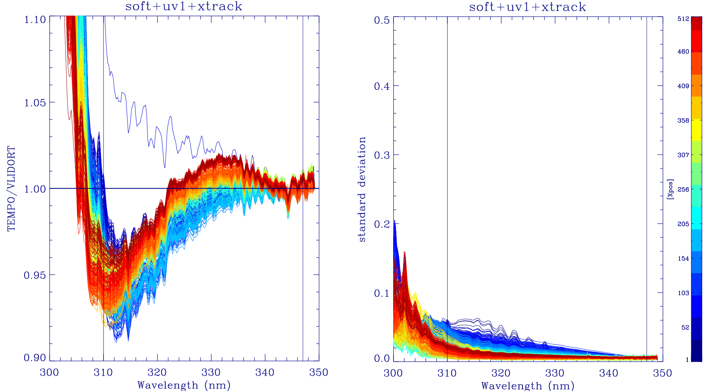
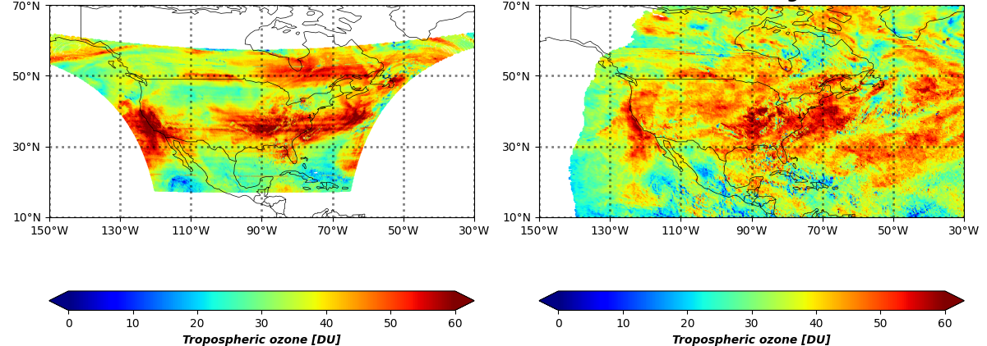
Algorithm Updates for TEMPO V4
Total O_{3:} L1b improvement and
  Update LUTs with average on-orbit slit functions
  Perform additional soft calibrations using NPP OMPS data
  Quality flag updates.
Profile O_{3 :} L1b improvement and
  Additional soft calibration
  Optimization in a priori, surface albedo, and measurement error constraint
7/26/2024
UVAI bias reduced from -2 in V3 to 0 in V4* (mostly from L1b)
V3: TEMPO-NPP
Lat. depen. reduced from soft cal.
V4*: TEMPO-NPP
V3 soft cal.
7/26/2024
6/12/2024 S006
V4* soft cal.
7/26/2024
Credit: Matthew Johnson
8/08/2024 S008
V4*: This version is subject to change before public release of V4.

Slide 10
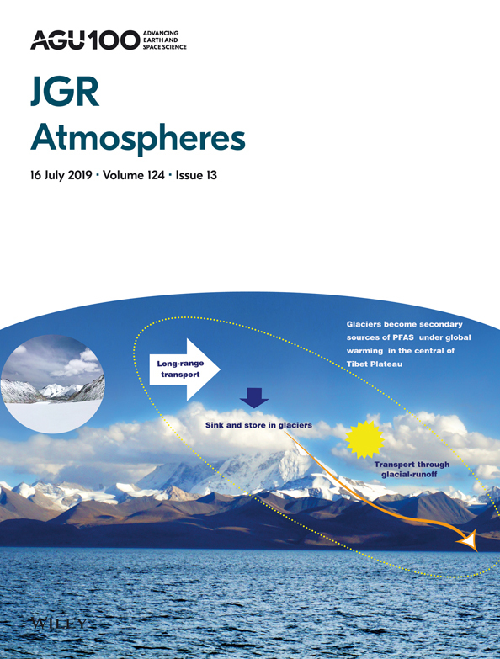
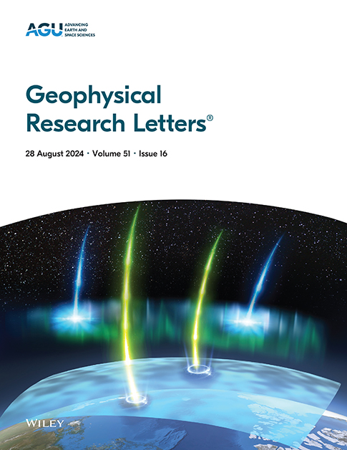
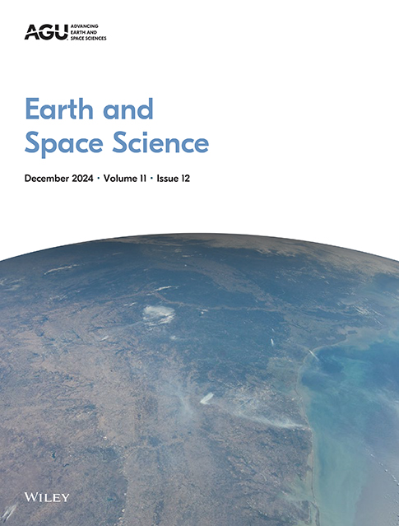
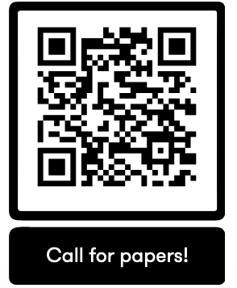
TEMPO AGU Special Collection
Call for Papers
TEMPO Data Products, Science, and Applications
Submission Deadline: December 31, 2025
Currently, 21 papers were submitted and 5 papers were published.

Slide 11
Summary and Outlook
TEMPO operations are nominal, and instrument is performing very well.
Mission extended to September 2026, further extension via Senior Review
V3 L1b, cloud, NO₂, HCHO, total O₃ are publicly available and upgraded to provisional status. O₃ profile product is operationally produced.
Significantly improved V4 data products including ozone profile and V2 NRT products will be released in mid-September 2025
Many more TEMPO products to come!
AGU Special Collection “TEMPO data products, science and applications” are open until 12/31/2025.
Acknowledgements: Funding from NASA (TEMPO, NNL13AA09C; SNWG TEMPO NRT, 80MSFC24CA004)
Thank you!

Slide 12










